Slide 1
CSE322
PUMPING LEMMA FOR REGULAR SETS AND ITS APPLICATIONS
Lecture #11

Slide 2
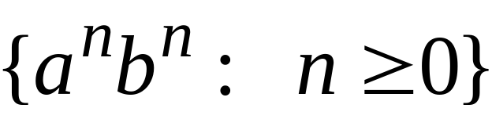
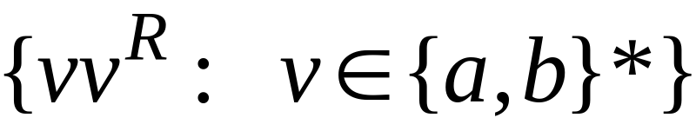


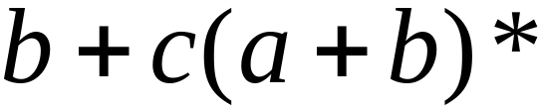

Non-regular languages
Regular languages

Slide 3

How can we prove that a language
is not regular?
Prove that there is no DFA that accepts
Problem: this is not easy to prove
Solution: the Pumping Lemma !!!

Slide 4

The Pigeonhole Principle

Slide 5


pigeons
pigeonholes

Slide 6
A pigeonhole must
contain at least two pigeons

Slide 7



pigeons
...........
pigeonholes
...........

Slide 8
The Pigeonhole Principle
pigeons
pigeonholes
There is a pigeonhole
with at least 2 pigeons
...........

Slide 9
The Pigeonhole Principle and
DFAs

Slide 10




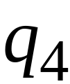


DFA with states

Slide 11
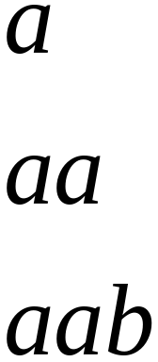
In walks of strings:
no state
is repeated

Slide 12
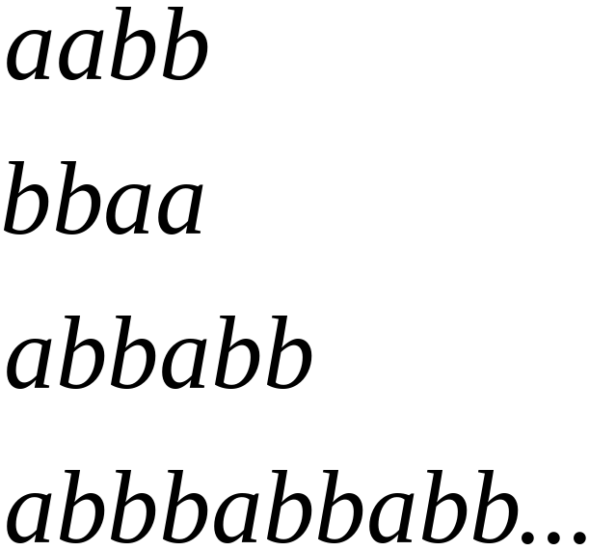
In walks of strings:
a state
is repeated

Slide 13

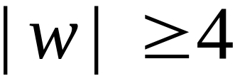
If string has length :
Then the transitions of string
are more than the states of the DFA
Thus, a state must be repeated

Slide 14



In general, for any DFA:
String has length number of states
A state must be repeated in the walk of
walk of
......
......
Repeated state

Slide 15
In other words for a string :
transitions are pigeons
states are pigeonholes
walk of
......
......
Repeated state

Slide 16
The Pumping Lemma

Slide 17
Pumping Lemma : If L is an infinite language then there exists some positive integer ‘n’ n is pumping length such that any string W E L has length greater than equal to ‘n’ i.e |w| >= n then w canbe devided into 3 parts, w= xyz and satisfy these conditions :

Slide 18
1. for each i>=0 , xy^iz E L
2.|y| >0 and
3. |xy| <= n
Eg: a^nb^2n n>=0
Lets take a string aabbbb E L yes
Aa = x bb=y bb=z
Pump y then aa bbbb bb E L No
Test fail so its not a regular.

Slide 19

Take an infinite regular language
There exists a DFA that accepts
states

Slide 20

Take string with
There is a walk with label :
.........
walk

Slide 21
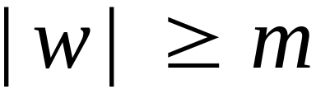
If string has length
(number
of states
of DFA)
then,
a state is repeated in the walk
......
......
walk

Slide 22


Slide 23
Let be the first state repeated in the
walk of
......
......
walk

Slide 24




Write
......
......

Slide 25


Observations:
length
number
of states
of DFA
length
......
......

Slide 26

Observation:
The string
is accepted
......
......

Slide 27

Observation:
The string
is accepted
......
......

Slide 28

Observation:
The string
is accepted
......
......

Slide 29
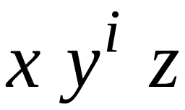

In General:
The string
is accepted
......
......

Slide 30
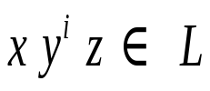
In General:
Language accepted by the DFA
......
......

Slide 31
In other words, we described:
The Pumping Lemma !!!

Slide 32


The Pumping Lemma:
Given a infinite regular language
there exists an integer
for any string with length
we can write
with and
such that:

Slide 33
Applications of the Pumping Lemma

Slide 34

Theorem:
The language
is not regular
Proof:
Use the Pumping Lemma

Slide 35
Assume for contradiction
that is a regular language
Since is infinite
we can apply the Pumping Lemma

Slide 36

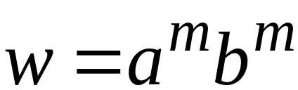
Let be the integer in the Pumping Lemma
Pick a string such that:
length
We pick

Slide 37
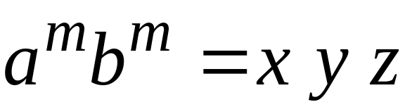

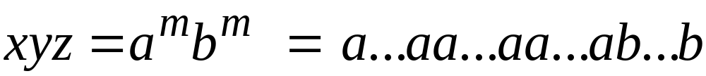
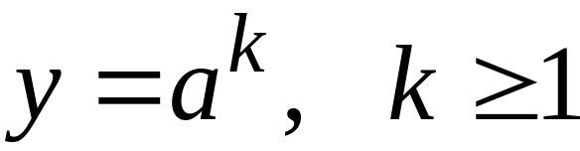
Write:
From the Pumping Lemma
it must be that length
Thus:

Slide 38
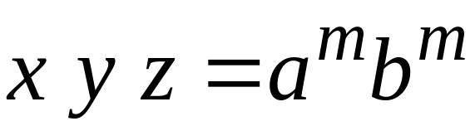

From the Pumping Lemma:
Thus:

Slide 39

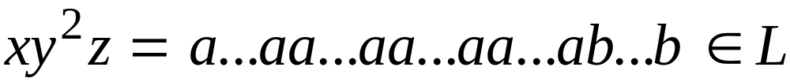
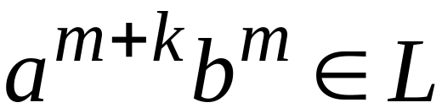
From the Pumping Lemma:
Thus:

Slide 40
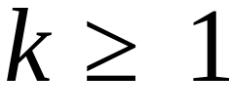
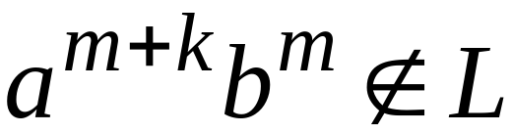
BUT:
CONTRADICTION!!!

Slide 41
Therefore:
Our assumption that
is a regular language is not true
Conclusion:
is not a regular language

Slide 42
Non-regular languages
Regular languages

Slide 43
More Applications of the Pumping Lemma

Slide 44
The Pumping Lemma:
Given a infinite regular language
there exists an integer
for any string with length
we can write
with and
such that:

Slide 45
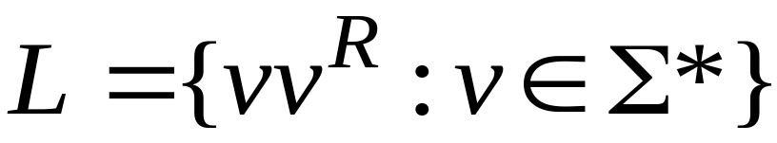
Non-regular languages
Regular languages

Slide 46

Theorem:
The language
is not regular
Proof:
Use the Pumping Lemma

Slide 47
Assume for contradiction
that is a regular language
Since is infinite
we can apply the Pumping Lemma

Slide 48
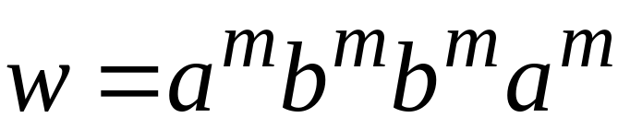
Let be the integer in the Pumping Lemma
Pick a string such that:
and
length
We pick

Slide 49
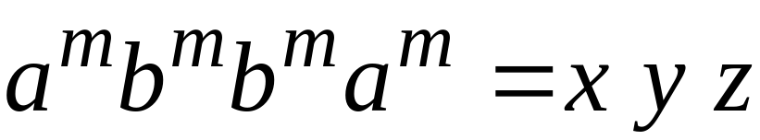
Write
From the Pumping Lemma
it must be that length
Thus:

Slide 50
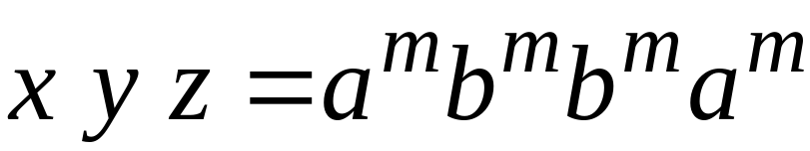
From the Pumping Lemma:
Thus:

Slide 51

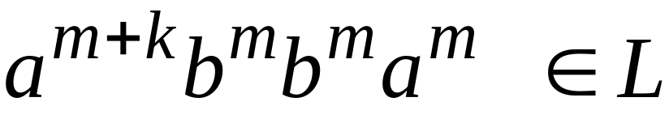
From the Pumping Lemma:
Thus:

Slide 52

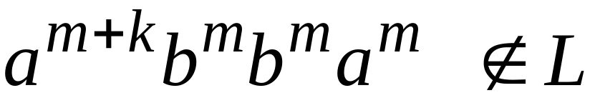
BUT:
CONTRADICTION!!!

Slide 53
Therefore:
Our assumption that
is a regular language is not true
Conclusion:
is not a regular language

Slide 54

Non-regular languages
Regular languages

Slide 55
Theorem:
The language
is not regular
Proof:
Use the Pumping Lemma

Slide 56
Assume for contradiction
that is a regular language
Since is infinite
we can apply the Pumping Lemma

Slide 57
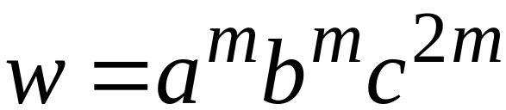
Let be the integer in the Pumping Lemma
Pick a string such that:
and
length
We pick

Slide 58
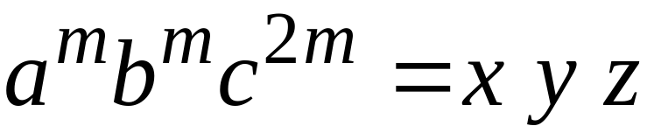

Write
From the Pumping Lemma
it must be that length
Thus:

Slide 59
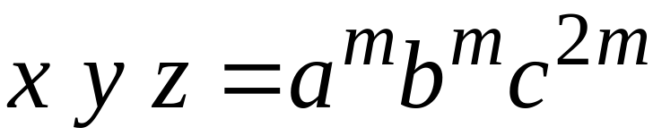
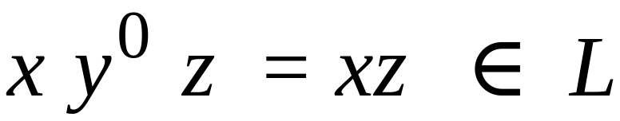
From the Pumping Lemma:
Thus:

Slide 60
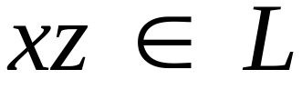

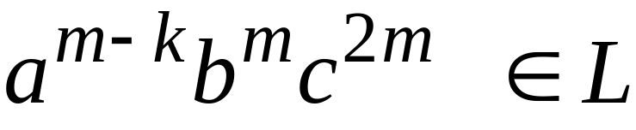
From the Pumping Lemma:
Thus:

Slide 61
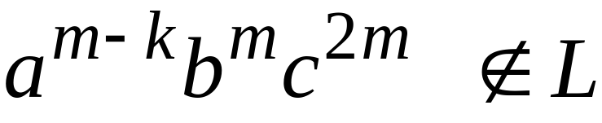
BUT:
CONTRADICTION!!!

Slide 62
Therefore:
Our assumption that
is a regular language is not true
Conclusion:
is not a regular language

Slide 63
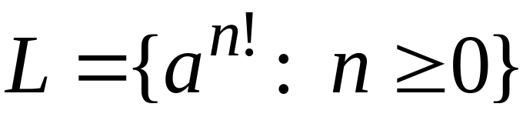
Non-regular languages
Regular languages

Slide 64
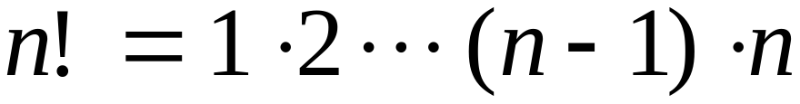
Theorem:
The language
is not regular
Proof:
Use the Pumping Lemma

Slide 65
Assume for contradiction
that is a regular language
Since is infinite
we can apply the Pumping Lemma

Slide 66
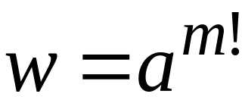
Let be the integer in the Pumping Lemma
Pick a string such that:
length
We pick

Slide 67
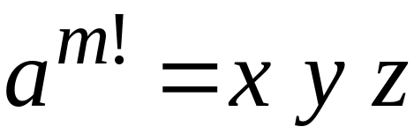

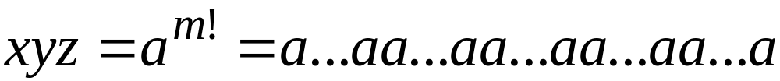
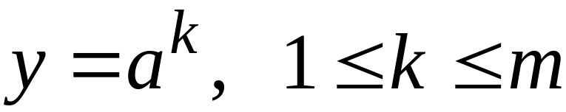
Write
From the Pumping Lemma
it must be that length
Thus:

Slide 68
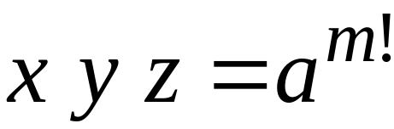
From the Pumping Lemma:
Thus:

Slide 69
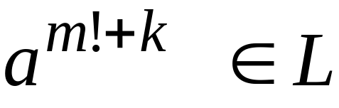
From the Pumping Lemma:
Thus:

Slide 70
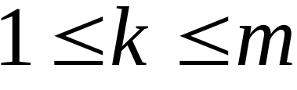

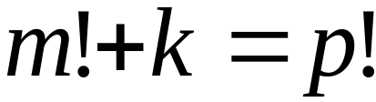
Since:
There must exist such that:

Slide 71

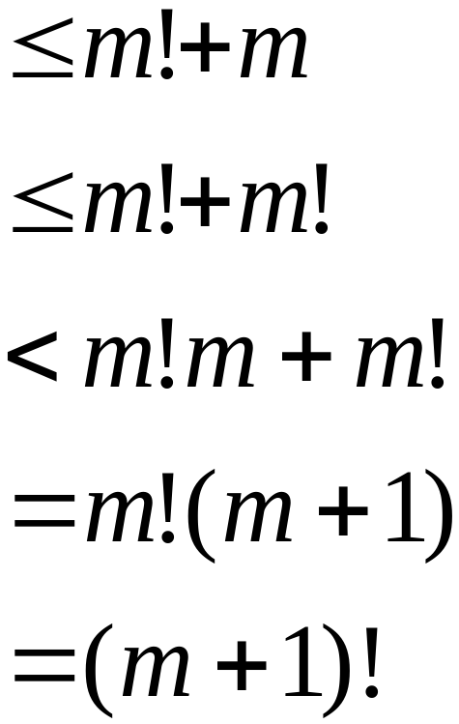

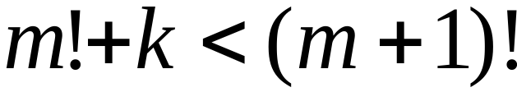
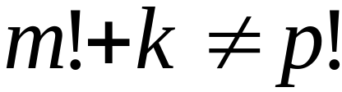
However:
for
for any

Slide 72
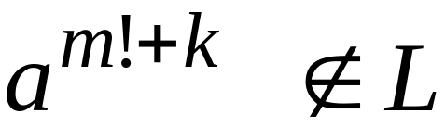
BUT:
CONTRADICTION!!!

Slide 73
Therefore:
Our assumption that
is a regular language is not true
Conclusion:
is not a regular language

